Slide 1
TRACK AND TRACE SUPPLY CHAIN
PIP2001 Capstone Project
Review-1
Batch Number:213
Roll | Name
20211CSE0878 | Aditya Kumar Jha
20211CSE0862 | Sourav Bhowmick
20211CSE0830 | Aaditya Kumar
20211CSE0849 | Abhinav Kumar Singh
Under the Supervision of,
Dr.Abdul Khadar A
Professor / Associate Professor / Assistant Professor
School of Computer Science and Engineering
Presidency University
Name of the Program: B.tech Computer Science and Engineering
Name of the HoD: Dr Asif Mohammad H B
Name of the Program Project Coordinator: Mr Amarnath J L
Name of the School Project Coordinators: Dr. Sampath A K / Dr. Abdul Khadar A / Mr. Md Ziaur Rahman

Slide 2
Introduction
In today's globalized economy, ensuring transparency and authenticity in supply chains is becoming increasingly critical. With the sheer volume of products being distributed worldwide, companies face significant challenges in tracking each unit from production to the consumer’s hands.
Our project aims to develop an innovative Track and Trace Solution that leverages modern technologies to provide seamless, real-time tracking of consumer goods through their entire journey. By utilizing automated identification techniques and a centralized data management system, we aim to minimize human intervention, enhance accuracy, and ensure complete visibility in the supply chain. This will not only improve operational efficiency but also build greater trust among consumers by offering them the ability to verify product authenticity.

Slide 3
Literature Review
1. Evolution of Supply Chain Tracking Technologies:
Over the years, barcode scanning and radio-frequency identification (RFID) have been the most widely used technologies in tracking product movement through the supply chain. These systems provide a basic level of visibility but come with limitations when scaled across multiple distribution points.
Reference: K. Finkenzeller, "RFID Handbook: Fundamentals and Applications in Contactless Smart Cards, Radio Frequency Identification and Near-Field Communication," Wiley, 2010.
2. Current State of Supply Chain Transparency:
According to a study by S. Chopra (2019), many companies face challenges in monitoring products due to fragmented and siloed data systems. This results in poor integration between production sites, warehouses, and distribution channels.
Reference: S. Chopra, “Supply Chain Management: Strategy, Planning, and Operation,” Pearson Education, 2019.
3. Role of Blockchain in Supply Chain Management:
Recent advancements in blockchain technology have revolutionized the way supply chains operate. Research shows that blockchain’s decentralized ledger provides end-to-end traceability, ensuring that every participant in the supply chain can view the history and authenticity of the product.
Reference: M. Saberi et al., "Blockchain Technology and Its Relationships to Sustainable Supply Chain Management," International Journal of Production Research, vol. 57, pp. 2117-2135, 2019.
4. Automated Identification and Data Capture (AIDC):
Studies by L. Heese (2018) indicate that AIDC systems, including QR codes and smart sensors, have been instrumental in tracking assets, providing real-time data collection with minimal human effort. These methods, however, are often limited by infrastructure costs and system integration challenges.
Reference: L. Heese et al., "Automated Identification Systems for Logistics Management: Implications and Applications," Logistics Research Journal, vol. 16, no. 2, 2018.
5. Challenges in Global Supply Chain Management:
R. Christopher (2016) discusses the challenges of handling the complexity of global supply chains, especially in tracking products across multiple countries and stakeholders. Inefficient tracking systems result in increased product counterfeiting and delayed deliveries.
Reference: R. Christopher, "Logistics and Supply Chain Management," Financial Times Prentice Hall, 2016.

Slide 4
Literature Review
6. Real-Time Tracking Systems:
C. Wang et al. (2020) highlights the importance of real-time tracking for perishable goods. Their research shows that tracking systems integrated with IoT sensors can reduce spoilage by monitoring environmental conditions such as temperature and humidity.
Reference: C. Wang et al., “IoT-Enabled Real-Time Supply Chain Management,” Journal of Internet Technology, vol. 21, no. 1, 2020.
7. Cloud-Based Solutions for Supply Chain Integration:
N. Lobo (2020) discusses the shift towards cloud-based systems that provide real-time visibility and enhance collaboration across all stakeholders. These platforms allow companies to collect and analyze data from multiple points in the supply chain.
Reference: N. Lobo, "Cloud Computing and Supply Chain Integration: A Digital Transformation," Supply Chain Journal, vol. 7, pp. 45-60, 2020.
8. QR Codes for Supply Chain Tracking:
QR codes have become increasingly popular in supply chain management for tracking individual units of products due to their ease of use and cost-effectiveness. S. Liu (2017) points out that QR codes are especially useful for tracking small consumer goods, though they can be vulnerable to damage and manipulation.
Reference: S. Liu, "Utilizing QR Codes in Supply Chain Management," International Journal of Logistics Systems and Management, 2017.
9. Machine Learning in Supply Chain Prediction:
According to J. Lee (2020), machine learning algorithms can be applied to predict potential bottlenecks and risks in the supply chain, enabling companies to take preventive action. However, their effectiveness depends heavily on the availability of quality data.
Reference: J. Lee et al., "Predictive Analytics in Supply Chain Management: A Machine Learning Approach," Expert Systems with Applications, vol. 142, 2020.
10. Gaps in Current Literature and Industry Practices:
While various methods like RFID, blockchain, and IoT have been explored, few solutions integrate them effectively to provide a fully automated, scalable, and real-time supply chain tracking system. Most existing solutions are limited by high costs, data fragmentation, and technical complexity. These gaps highlight the need for a comprehensive, automated tracking system that minimizes human intervention and is scalable for global supply chains.
Reference: Sweeney, E. (2013). Supply Chain Benchmarking: Performance Measurement and Metrics. International Journal of Logistics Management, 24(2), 184-206.

Slide 5
Existing method Drawback
Existing Method: RFID/Barcode-Based Tracking Systems
Drawbacks:
Limited Scalability and Automation:
  These systems require manual scanning at each checkpoint (e.g., warehouses, shipping locations, and retail points), making them inefficient in large-scale operations. Manual processes introduce delays and increase the likelihood of human error, especially in high-volume environments.
Lack of Real-Time Data:
  RFID or barcode systems do not provide real-time tracking. Products are only scanned at certain points in the supply chain, leaving large gaps in visibility between those checkpoints. If issues like theft, damage, or environmental changes (e.g., temperature fluctuation) occur between scans, they remain undetected until the next checkpoint.
Fragmented Data Across Stakeholders:
  Since each stakeholder (e.g., manufacturer, distributor, retailer) may use their own systems for tracking and managing supply chain data, it results in data silos. Information is not always shared in real-time, leading to inefficiencies and delays in decision-making, particularly in global supply chains involving multiple parties.
High Initial Costs for RFID:
  While barcode systems are cost-effective, RFID tags can be expensive, especially when applied to low-cost or high-volume goods. For smaller companies or companies with a large variety of products, implementing RFID can be financially impractical.

Slide 6
Proposed Method
IoT-Enabled Real-Time Tracking:
IoT sensors will be embedded in products, pallets, or transportation vehicles to continuously monitor the location and condition of goods throughout the supply chain.
These sensors will provide real-time data on environmental factors such as temperature, humidity, and physical conditions, which are particularly important for perishable goods (e.g., food or pharmaceuticals).
This eliminates the dependency on manual scanning at checkpoints, offering continuous tracking rather than point-in-time updates.
Blockchain for Data Transparency and Security:
A blockchain-based system will be used to record all transactions and movements of goods across the supply chain, ensuring that the data is immutable, secure, and tamper-proof.
Blockchain provides transparent and verifiable data for all stakeholders (manufacturers, distributors, retailers, etc.), which helps improve trust and accountability.
The use of smart contracts on the blockchain will automate payments, triggers for reordering, or quality control checks based on real-time conditions.
Cloud-Based Data Integration:
A cloud computing platform will serve as a central hub to collect and integrate data from various IoT devices and blockchain records.
Stakeholders will have real-time access to supply chain data through dashboards and analytics tools, improving decision-making, visibility, and collaboration.
The system will offer cross-platform compatibility and integration with existing Enterprise Resource Planning (ERP) or Warehouse Management Systems (WMS).

Slide 7
Objectives
Develop a Comprehensive Tracking Solution
Design an end-to-end supply chain solution to track millions of product units from their point of origin (e.g., farms, factories) to the retailer. The solution should ensure transparency across the entire supply chain.
Minimize Human Effort in Data Capture and Tracking
Automate the tracking process as much as possible, reducing manual data entry and human intervention to improve accuracy and efficiency in the supply chain.
Implement Beyond Distributor-Level Tracking
Overcome the limitations of traditional barcode-based tracking systems, which are difficult to manage beyond the distributor level, ensuring visibility at each stage.
Leverage Advanced Technologies
Incorporate innovative technologies like RFID, IoT, blockchain, or AI to enhance product traceability, reduce counterfeiting, and improve real-time decision-making capabilities.
Ensure Data Accuracy and Security
Develop mechanisms to safeguard the data integrity and security of the tracked items, ensuring reliable traceability and preventing tampering or fraud.
Optimize Supply Chain Operations
Improve supply chain efficiency by providing real-time insights on product locations, reducing loss, theft, and delays through accurate tracking data.
Provide User-Friendly and Scalable Solution
Ensure the solution is easy to deploy and scale across various geographic regions, supporting large volumes of data and users.

Slide 8
Methodology/Modules
Requirement Analysis
Identify the critical points in the supply chain where tracking is necessary (e.g., farm, factory, distributor, retailer).
Define the data types to be captured (e.g., product origin, batch number, timestamps, transportation details).
Gather requirements from stakeholders to understand their expectations and limitations.
Technology Selection
Evaluate technologies like RFID, IoT sensors, GPS tracking, blockchain, or QR codes for implementing the track-and-trace system.
Select a technology stack that supports scalability, real-time tracking, and secure data handling.
System Design and Architecture
Design a scalable architecture for data collection, storage, and processing.
Create an interface that allows users to view real-time product movement through dashboards or mobile apps.

Slide 9
Methodology/Modules
Development and Integration
Develop the core modules for data capturing, real-time tracking, and supply chain analytics.
Integrate the tracking system with existing supply chain management tools (e.g., ERP systems).
Testing and Validation
Perform unit and system-level testing to ensure data accuracy, security, and system reliability.
Conduct pilot testing with a subset of products to validate the system in real-world conditions.
Deployment and Maintenance
Deploy the solution across the supply chain.
Ensure continuous monitoring and updates for the system as needed.

Slide 10
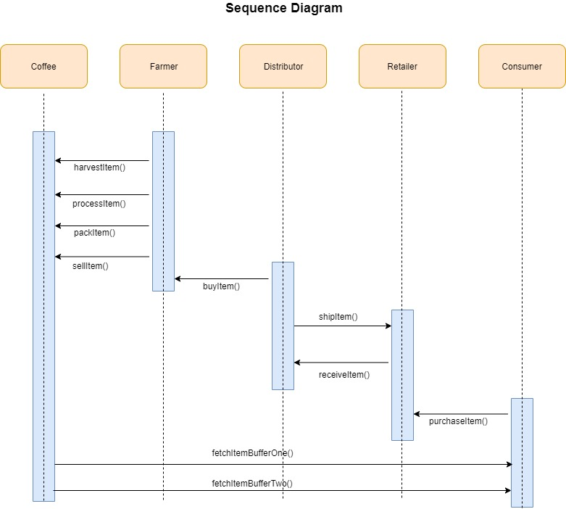
This Sequence Diagram outlines the coffee supply chain process:
Farmer: Harvests, processes, packs, and sells coffee (`harvestItem()`, `processItem()`, `packItem()`, `sellItem()`).
2. Distributor: Buys and ships coffee
(`buyItem()`, `shipItem()`).
3. Retailer: Receives coffee
(`receiveItem()`).
4. Consumer: Purchases coffee
(`purchaseItem()`).
5. Data Retrieval:
`fetchItemBufferOne()` and
`fetchItemBufferTwo()` track
details.
It ensures transparency and traceability across the supply chain.

Slide 11
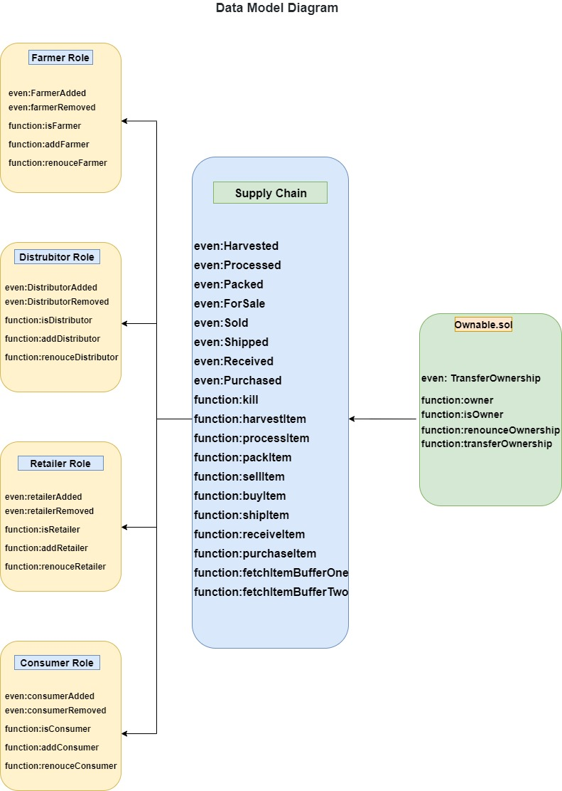
The Data Model Diagram
This Data Model Diagram represents the roles and functions in a supply chain system built on a blockchain framework. Here's a brief explanation:
Components:
1. Farmer Role:
- Events: `FarmerAdded`, `farmerRemoved`.
- Functions: `isFarmer`, `addFarmer`, `renounceFarmer`.
- Manages farmer-related activities.
2. Distributor Role:
- Events: `DistributorAdded`, `DistributorRemoved`.
- Functions: `isDistributor`, `addDistributor`, `renounceDistributor`.
- Handles distribution-related tasks.
3. Retailer Role:
- Events: `RetailerAdded`, `RetailerRemoved`.
- Functions: `isRetailer`, `addRetailer`, `renounceRetailer`.
- Focuses on retailer operations.
4. Consumer Role:
- Events: `ConsumerAdded`, `ConsumerRemoved`.
- Functions: `isConsumer`, `addConsumer`, `renounceConsumer`.
- Defines consumer activities.
5. Supply Chain Module:
- Events: Track item status (e.g., `Harvested`, `Processed`, `Packed`, `Sold`, `Shipped`, `Received`, `Purchased`).
- Functions: Handle item processing and transaction workflows (e.g., `harvestItem`, `processItem`, `sellItem`, `shipItem`).
6. Ownable Module:
- Manages ownership of the system.
- Functions: `isOwner`, `transferOwnership`..

Slide 12
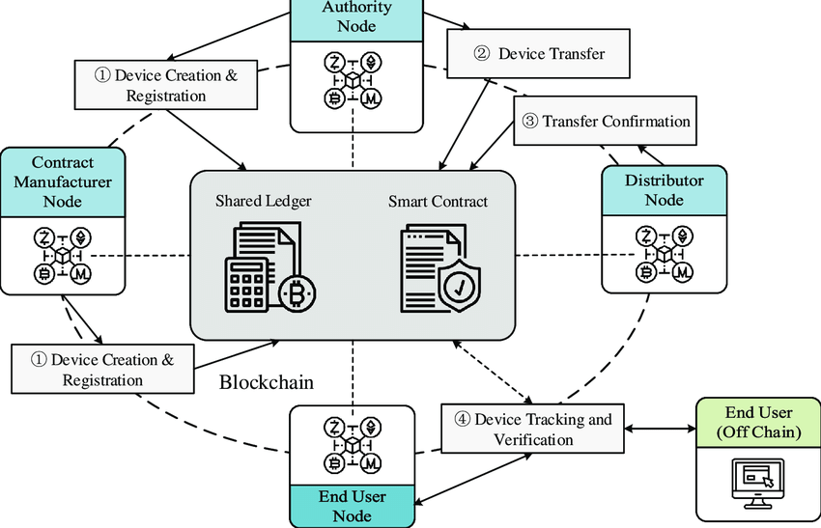
Architecture

Slide 13
Hardware/software components
Software Components:
Blockchain Platform
IoT Management Platform
Data Analytics & Visualization Tools
Mobile & Web Applications
Database & Storage
Security Tools
Hardware Components:
RFID Tags & Readers
IoT Sensors
NFC Tags (Optional)
IoT Gateways
Cloud Infrastructure

Slide 14
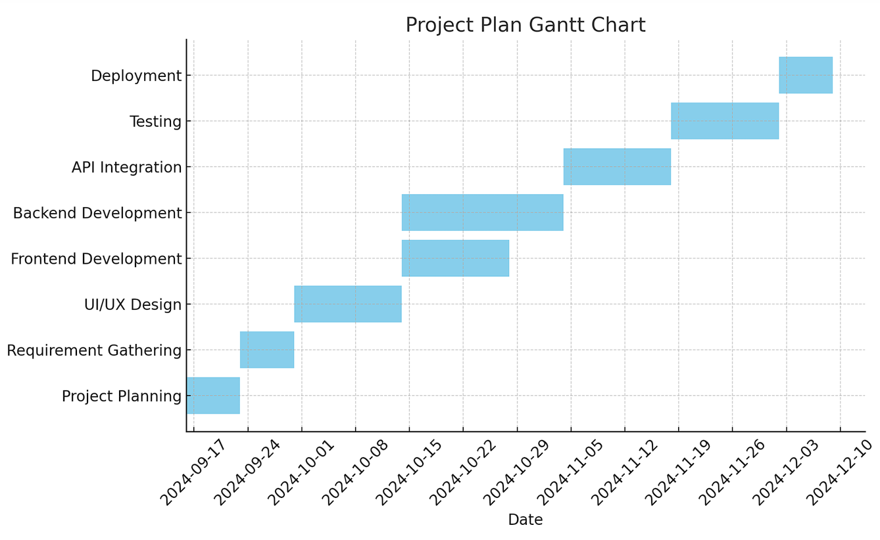
.
Timeline of Project

Slide 15
Expected Outcomes
1. Improved Supply Chain Transparency
Every product will be traceable from its point of origin to the retailer, ensuring full visibility for all stakeholders in the supply chain.
This transparency builds trust among partners, reduces inefficiencies, and mitigates risks like theft, counterfeiting, or product tampering​
2. Enhanced Data Security and Integrity
The use of blockchain ensures that all data recorded in the system is immutable and tamper-proof. This secures the product's journey across the supply chain, making it impossible to falsify data​.
Stakeholders can confidently verify the authenticity of products, reducing fraud or errors in the supply chain.
3. Real-Time Monitoring and Decision-Making
With IoT sensors and RFID/NFC tags, real-time tracking of product status, environmental conditions, and location becomes possible, allowing stakeholders to take immediate action when problems arise, such as a temperature deviation or delivery delay​
Predictive analytics help forecast supply chain disruptions, allowing for proactive adjustments to avoid delays.
4. Increased Efficiency and Cost Reduction
Automation of data collection through IoT and RFID/NFC reduces manual intervention, minimizing human error and cutting operational costs.
Optimized routes and better inventory management reduce wasted time and resources in the supply chain​
5. Consumer Trust and Product Verification
Consumers and retailers can verify the origin, authenticity, and quality of products using the tracking system. This is especially beneficial for high-value or perishable goods, where quality and authenticity are critical​.

Slide 16
Conclusion
The Track and Trace Supply Chain project offers a comprehensive solution for real-time product tracking, increased transparency, and security throughout the supply chain. By integrating technologies like IoT, RFID/NFC, and blockchain, this system provides end-to-end visibility, allowing stakeholders to monitor products at every stage—from manufacturing to retail. The automation of data collection reduces human error and operational costs, while blockchain ensures data integrity and trust among supply chain participants.
The expected outcomes, such as enhanced transparency, real-time decision-making, and increased consumer trust, make this solution a game-changer in modern supply chain management. The scalability and secure infrastructure of the system can be applied across industries, ensuring improved efficiency, security, and accountability.

Slide 17
Github Link
The Github link provided should have public access permission.
Github Link :
https://github.com/abhinavs5040/Track-and-Trace-Supply-chain- project-.git

Slide 18
References
Finkenzeller, K. (2010). RFID Handbook: Fundamentals and Applications in Contactless Smart Cards, Radio Frequency Identification and Near-Field Communication. Wiley.
Chopra, S. (2019). Supply Chain Management: Strategy, Planning, and Operation. Pearson Education.
Saberi, M., Kouhizadeh, M., Sarkis, J., & Shen, L. (2019). Blockchain Technology and Its Relationships to Sustainable Supply Chain Management. International Journal of Production Research, 57(7), 2117-2135.
Heese, L., Wagner, S., & Mengel, S. (2018). Automated Identification Systems for Logistics Management: Implications and Applications. Logistics Research Journal, 16(2), 95-110.
Christopher, R. (2016). Logistics and Supply Chain Management. Financial Times Prentice Hall.
Wang, C., Zhou, L., Liu, X., & Zhang, J. (2020). IoT-Enabled Real-Time Supply Chain Management. Journal of Internet Technology, 21(1), 1-10.

Slide 19

Project work mapping with SDG

Slide 20
Thank You

